Slide 1
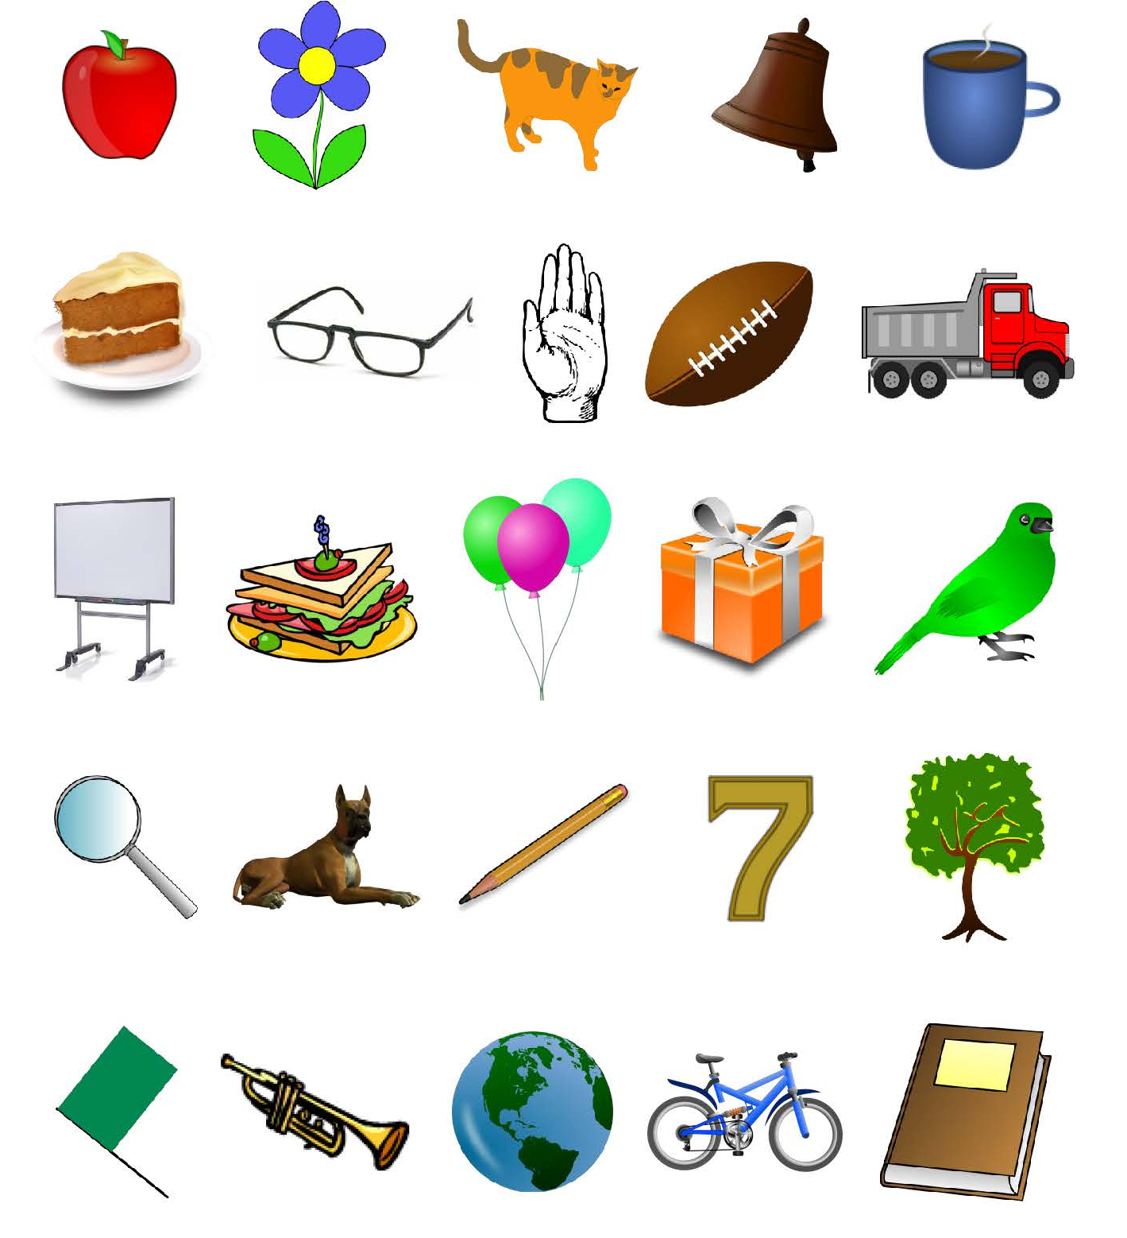
Experiment: Refresh Your Memory

