Slide 1

Putting Yourself in Someone Else’s Shoes
Ask yourself if you would like it if someone said that to you.
Imagine how they feel right now.
People like you more and are nicer to you when you treat them well.
Remember the Golden Rule: Treat others how you want to be treated.
Do you want to be part of the solution or the problem?
What would you want someone to do or say if you were in a tough situation?
It is a good idea to help those in trouble if it is safe.

Slide 2
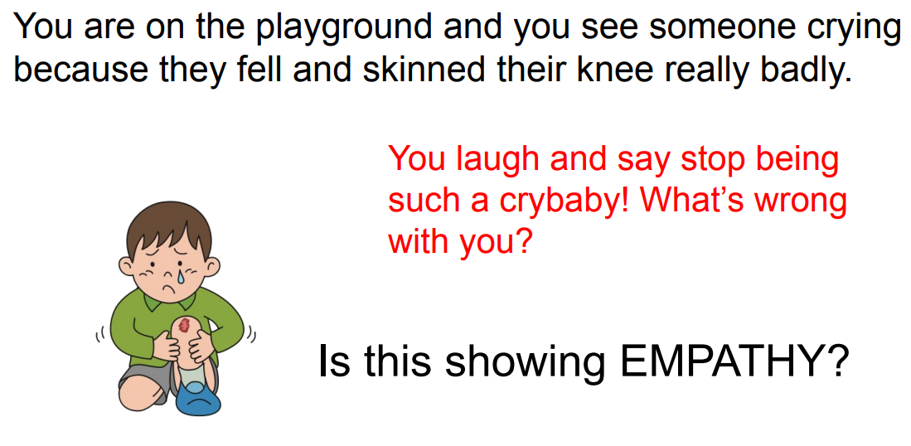
Ask yourself if you would like it if someone said that to you.
Imagine how they feel right now.
People like you more and are nicer to you when you treat them well.
Remember the Golden Rule: Treat others how you want to be treated.
Do you want to be part of the solution or the problem?
What would you want someone to do or say if you were in a tough situation?
It is a good idea to help those in trouble if it is safe.

Slide 3
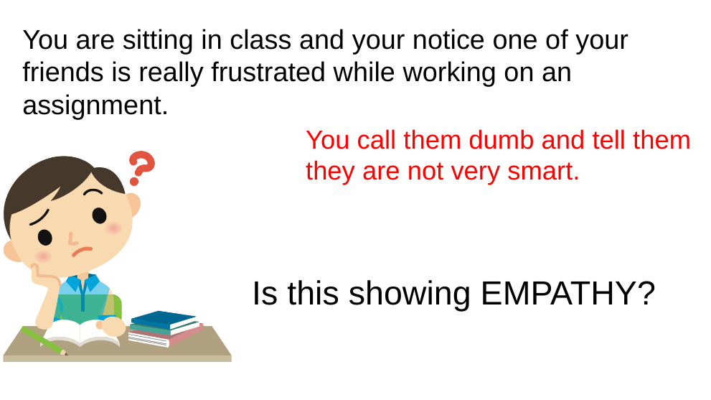
Ask yourself if you would like it if someone said that to you.
Imagine how they feel right now.
People like you more and are nicer to you when you treat them well.
Remember the Golden Rule: Treat others how you want to be treated.
Do you want to be part of the solution or the problem?
What would you want someone to do or say if you were in a tough situation?
It is a good idea to help those in trouble if it is safe.

Slide 4
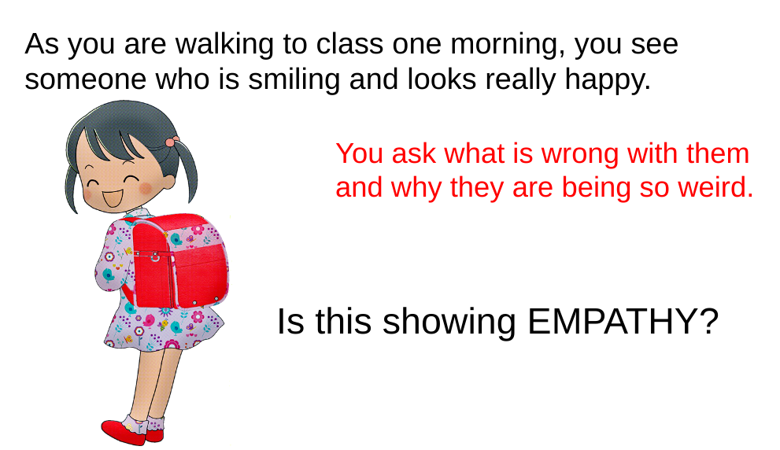
Ask yourself if you would like it if someone said that to you.
Imagine how they feel right now.
People like you more and are nicer to you when you treat them well.
Remember the Golden Rule: Treat others how you want to be treated.
Do you want to be part of the solution or the problem?
What would you want someone to do or say if you were in a tough situation?
It is a good idea to help those in trouble if it is safe.

Slide 5
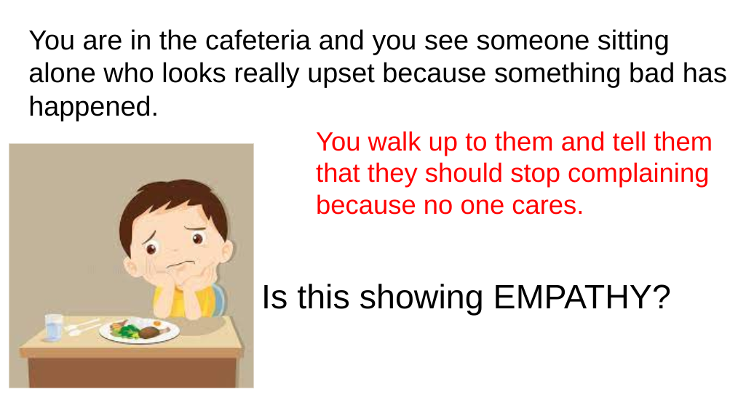
Ask yourself if you would like it if someone said that to you.
Imagine how they feel right now.
People like you more and are nicer to you when you treat them well.
Remember the Golden Rule: Treat others how you want to be treated.
Do you want to be part of the solution or the problem?
What would you want someone to do or say if you were in a tough situation?
It is a good idea to help those in trouble if it is safe.

Slide 6
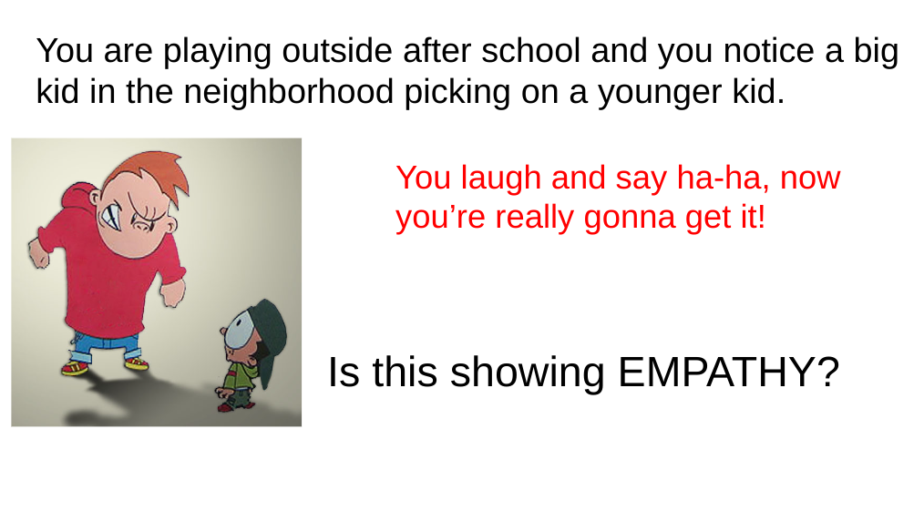
Ask yourself if you would like it if someone said that to you.
Imagine how they feel right now.
People like you more and are nicer to you when you treat them well.
Remember the Golden Rule: Treat others how you want to be treated.
Do you want to be part of the solution or the problem?
What would you want someone to do or say if you were in a tough situation?
It is a good idea to help those in trouble if it is safe.

Slide 7
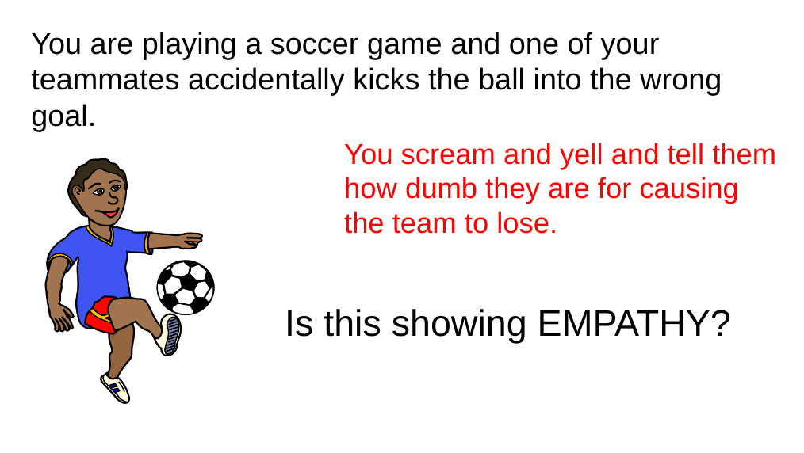
Ask yourself if you would like it if someone said that to you.
Imagine how they feel right now.
People like you more and are nicer to you when you treat them well.
Remember the Golden Rule: Treat others how you want to be treated.
Do you want to be part of the solution or the problem?
What would you want someone to do or say if you were in a tough situation?
It is a good idea to help those in trouble if it is safe.

Slide 8
Image Credits:
Heart Sneakers: https://www.pinterest.com/pin/353884483213824692/
Injured Boy: https://encrypted-tbn0.gstatic.com/images?q=tbn:ANd9GcRPY6B1W9Bot1zzWVOgGG7O3KZCS-UV17qPpUJfgM0aWMe-tQRM&s
Frustrated Student: https://encrypted-tbn0.gstatic.com/images?q=tbn:ANd9GcRkROEU2vQk9MGNbbNVdeLVUWKmMddrwEazkZLIPOP4MYVks8Y&s
Happy Girl with Backpack: https://encrypted-tbn0.gstatic.com/images?q=tbn:ANd9GcQmU2nYe4pStVBbCctDIx3Dbokou9veEqOrHS9GgqaW7hRGZA5a1oyB5A&s
Kid Upset at Lunch: https://www.google.com/imgres?imgurl=https%3A%2F%2Fthumbs.dreamstime.com%2Fb%2Fboy-bored-food-child-eating-boring-cute-little-78564708.jpg&imgrefurl=https%3A%2F%2Fwww.dreamstime.com%2Fillustration%2Feating-kid-sad.html&tbnid=lQrcVQzdxZOBEM&vet=12ahUKEwju6qL-g7_5AhUE81MKHYDIAzIQMygAegUIARC2AQ..i&docid=2ah4SAEyOVqYiM&w=800&h=800&q=sad%20kid%20alone%20eating%20cartoon&safe=active&ved=2ahUKEwju6qL-g7_5AhUE81MKHYDIAzIQMygAegUIARC2AQ
Bully: https://encrypted-tbn0.gstatic.com/images?q=tbn:ANd9GcQyzUcm1SYG6V_Lr7fY5JHxyf0hOfs6Du9Nr4aV5JIesPAEx4U&s
Soccer Player: https://encrypted-tbn0.gstatic.com/images?q=tbn:ANd9GcR8fbDNlbCu2a1gw4-n_V_djQfaWUUBMRuOSoElQehVR_2rRSi8&s

